Slide 1
MIPS Architecture
Multiply/Divide Functions & Floating Point
Chapter 4
By N. Guydosh
2/18/04

Slide 2
Multiplication Element for MIPS
First hardware algorithm is a take-off on “pencil and paper” method of multiplication.
This and the next two methods are only for unsigned multiplication.
  Shifts are logical shifts (pad with 0’s), rather then arithmetic shifts (sign bit extended/propagated).
Initial approach:
  Assume 32 bit registers for multiplier and multiplicand, and a 64 bit “double” register for the result (accumulator). Registers can be shifted.
  Initialize the accumulator to 0
  For each bit in the multiplier starting from low order (bit 0). Test by shifting left:
  If the multiplier bit is a 1: left shift the multiplicand one bit and add it to accumulator – ignore any carryout.
  If the multiplier bit is a 0, left shift the multiplicand one bit and add 0 (ie., do nothing).
  Using this straight forward method, the both the multiplicand and the product register would have to be 64 bits. And the multiplier 32 bits being shifted right. . . . See fig. 4.25, p. 251 and fig 4.27, p. 253 for example.

Slide 3
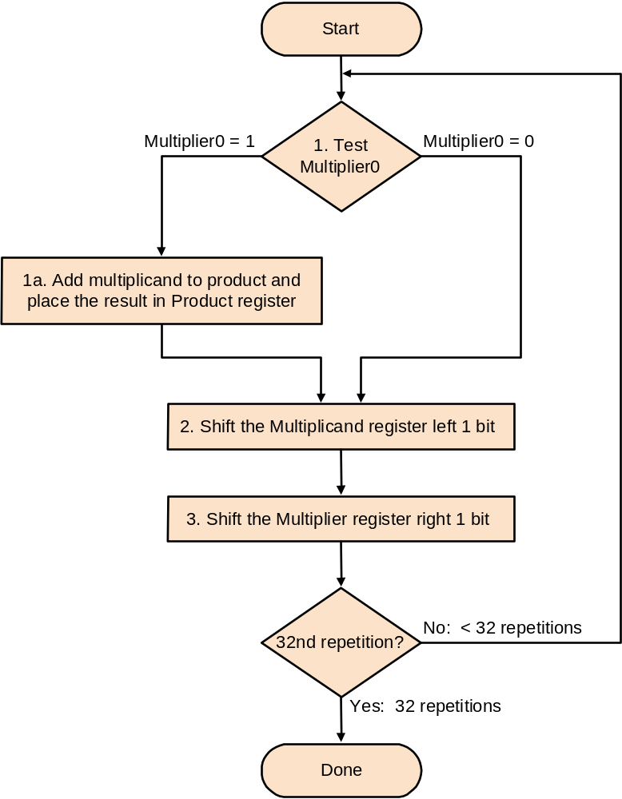
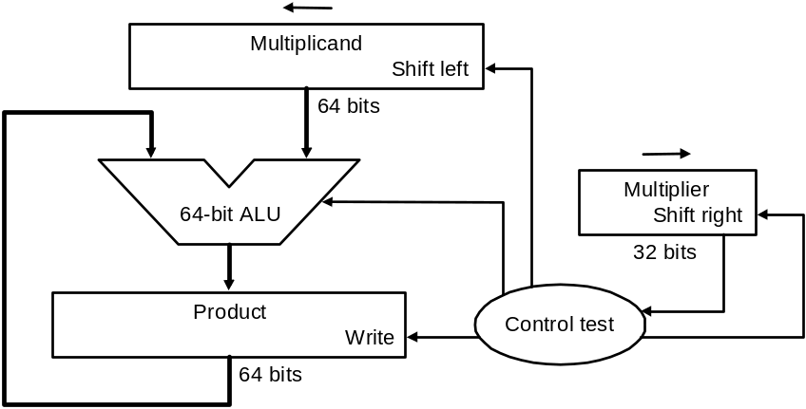
Unsigned Multiplication
Initial Approach Summary
See fig 4.27, p. 253 for example calculation.

Slide 4
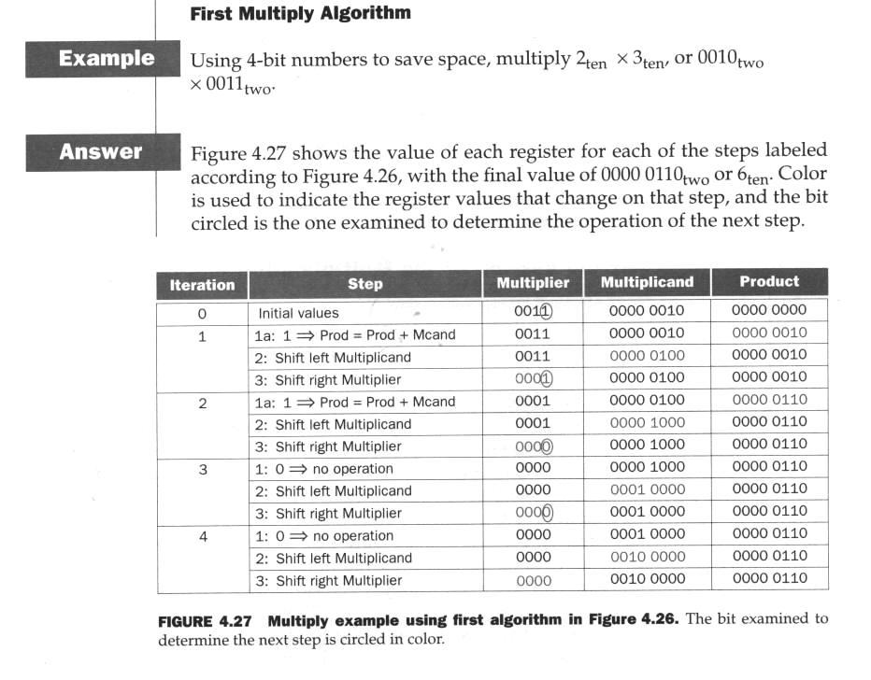
Multiply Initial Approach Summary - Example

Slide 5
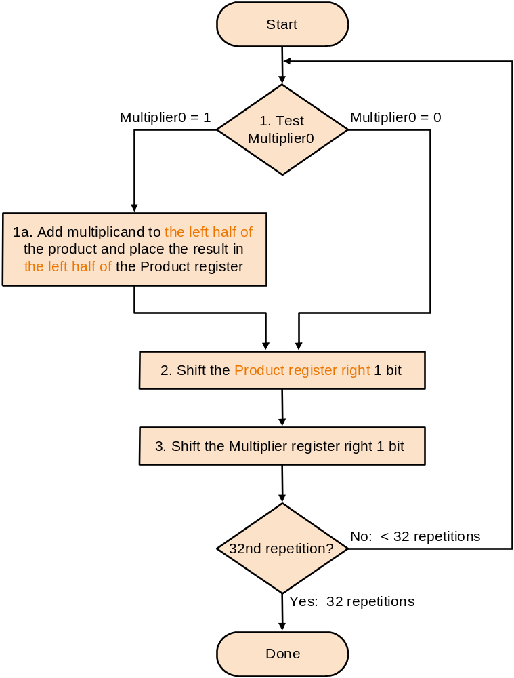
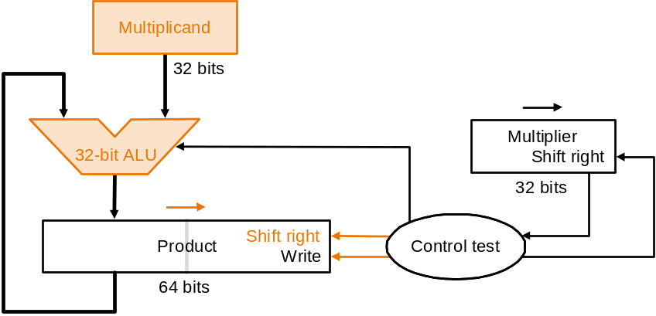
Unsigned Multiplication
2nd Approach – Small Variation on 1st Approach
Shift the product accumulator right instead of the multiplicand left, ie.,
keep multiplicand stationary
Sort of like, when driving to Syracuse via Rt. 81
keep the car stationary and move the
highway instead! Will still get you there & save
some gas in the mean time!

Slide 6
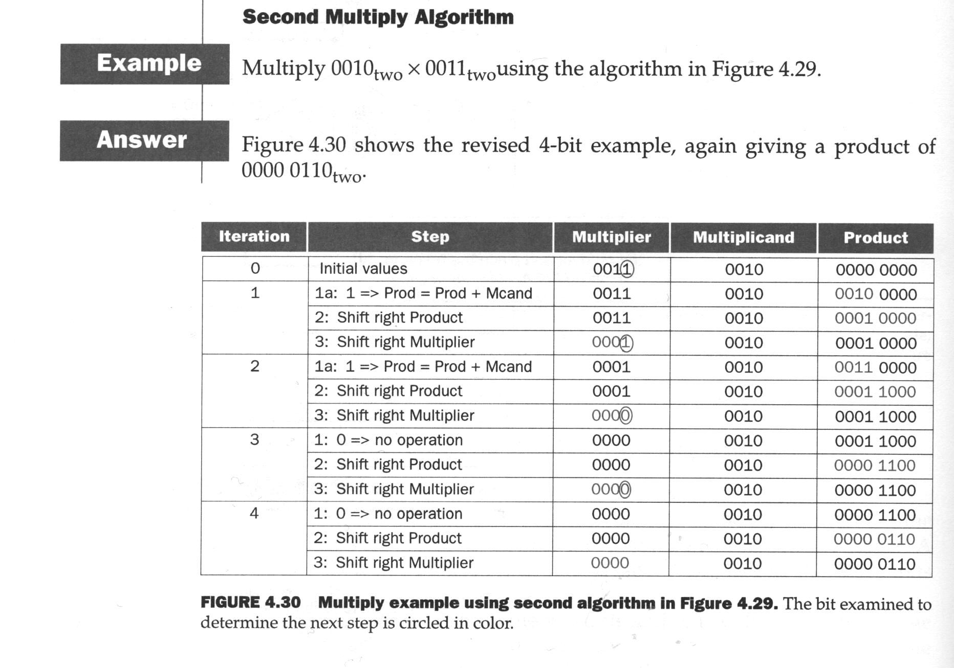
Multiply 2nd Approach - Example

Slide 7
Unsigned Multiplication
3rd & Final Multiplication Approach
High performance method (3rd version fig. 4.31, p. 257)
  As for the 2nd version, instead of shifting multiplicand left, shift the product register right –multiplicand is stationary.
  In the 2nd version, the 64 bit product register is only partially used during the process, let’s get rid of the 32 bit multiplier register, initialize the right half of the product register with the multiplier, and now begin building the product in the left half. . . .
  The product register is now shifted in the same direction as the old multiplier register.
  Each bit generated in the product will cause a multiplier bit to be shifted out of the register (to a “bit bucket”).- eventually the product replaces the multiplier.

Slide 8
Final algorithm for unsigned multiplication
Initialize product register to { 0x00000000 || <multiplier> }
... multiplier is 32 bits.
Do the following 32 times:
If least significant bit of product register == 1,
add multiplicand to left half of product register – ignoring any carryout
else
do nothing
Unconditionally shift product register right by 1 bit (low bit of multiplier shifted out of register).

Slide 9
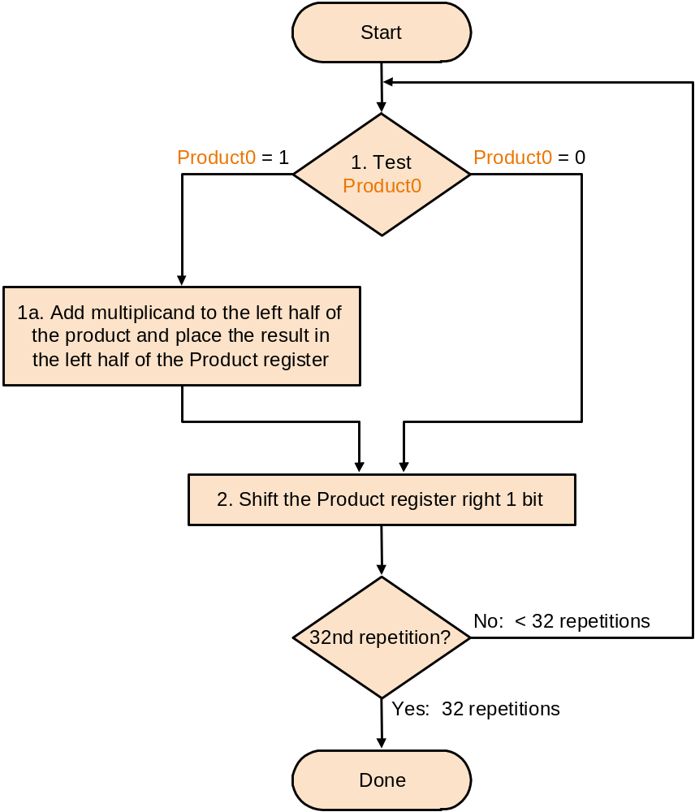
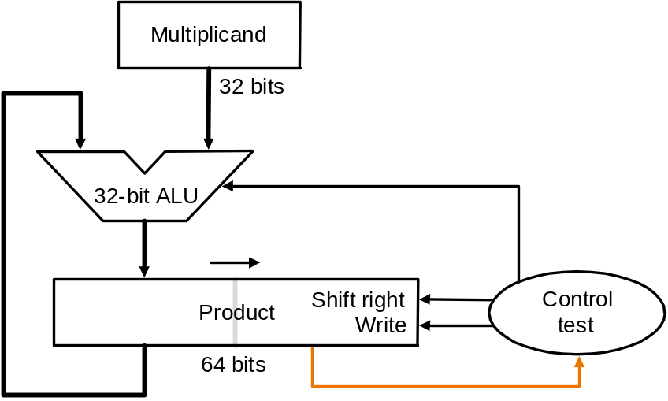
Unsigned Multiplication
3rd & Final Multiplication Approach
Final reminder: in all unsigned algorithms,
The shifts are logical shifts … padding is with
zeros rather than extending sign bit.

Slide 10
Unsigned Multiplication
3rd & Final Multiplication Approach) – an example.
0010 = 2 ... Multiplicand
x 0011 = 3 ... Multiplier
0110 = 6
Step# Action Multiplicand(M) Product (P)
0 initial 0010 0000 0011
1 1=> P=P+M|0000 0010 0010 0011
P >> 1 0010 0001 0001
2 1=> P=P+M|0000 0010 0011 0001
P >> 1 0010 0001 1000
3 0=> do nothing 0010 0001 1000
P >> 1 0010 0000 1100
4 0=> do nothing 0010 0000 1100
P >> 1 0010 0000 0110 <== ANS

Slide 11
Signed 2's Complement Multiplication
Booth’s Algorithm
Uses addition as well as subtraction in the multiplication process and is faster.
Works for signed 2's complement arithmetic also
Has same overall form as above algorithm exception the step:
“if low bit of product = 1, Add multiplicand to left half of product register”
Is replaced by the following new rule:
If low bit and shifted out bit of product = 00:
Do nothing
If low bit and shifted out bit of product = 01:
Add multiplicand to left half of product register
If low bit and shifted out bit of product = 10:
Subtract multiplicand to left half of product register
If low bit and shifted out bit of product = 11:
Do nothing
... The rest of the algorithm is the same.
Note 1: The this algorithm is easy to use, but hairy to theoretically prove.
Note 2: All shifting of the product extends the sign bit.

Slide 12
Interpretation of New Rule For Booth’s Algorithm
Now we now are testing 2 bits: LSB of product register and previous shifted out bit (initialized to 0 at the beginning):
  A way of detecting a run of consecutive ones in the multiplier:
  Multiplier being shifted out of the right side of the product register:
  end of run middle of run beginning of run
  000000000001111111111110000000000000
Current LSB bit | Previous shifted out bit | Explanation | example
1 | 0 | Beginning of a run of ones | 000011110000)₂
1 | 1 | Middle of a run of ones | 000011110000)₂
0 | 1 | End of a run of ones | 000011110000)₂
0 | 0 | Middle of a run of zeros | 000011110000)₂

Slide 13
Interpretation of New Rule For Booth’s Algorithm (cont)
Depending on the current bit (LSB) in the product register, and the previous shifted out bit, we have:
  00: middle of string of 0’s, so no arithmetic operation
  01: End of string of 1’’s, so add the multiplicand to the left half of th product register (ignore any net carry outs)
  10: beginning of a string of 1’s, so subtract the multiplicand from the left half of the product register (ignoring any net carry outs)
  11: Middle of a string of 1’s, so no arithmetic operation
Note that all the “action” (subtract or add) takes place only on “entering” or leaving a run of ones.

Slide 14
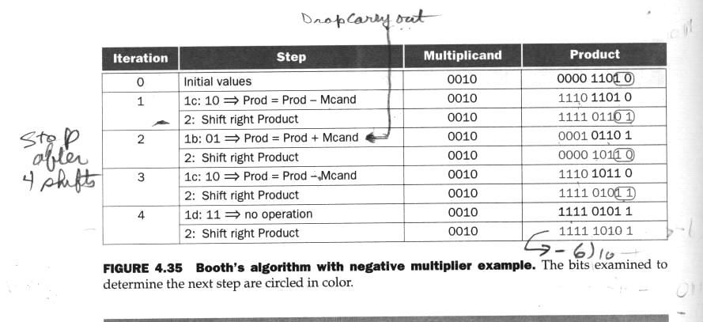
Example of Booth’s Algorithm
2)_{ten} x –3)_{ten} = -6)_{two} …where -3)_{ten} = 1101)_{two} is the multiplier
or
0010)_{two} x 1101)_{two} = 1111 1010)₂
… note the 2’s complement of 2)_{ten} = 0010)_{two} is 1110)_{two}
From Patterson &
Hennessy, p. 262

Slide 15
Hardware/Software Interface for Multiply
(see p. 264)
Special registers reserved for multiplication (and division): HI and LO
The concatenation of HI and LO (64 bits) holds the product
New instructions (all type R)
mult $2, $3 # HI,LO = $2*$3 ... signed multiplication
multu $2, $3 # HI,LO = $2*$3 ...unsigned multiplication
mfhi $1 # $1 = HI ... put a copy of HI IN $1
mflo $1 # $1 = LO ... put a copy of LO IN $1

Slide 16
Division Element for MIPS
Again hardware algorithm is a take-off on “pencil and paper” method of division
Based on the following “simple” algorithm.
  see fig 4.36, p. 266
  64 bit divisor register - shifts right
  32 bit quotient register - shifts left
  64 bit remainder register -shifts right
  64 bit ALU
  initialization:
  Put divisor in left half of 64 bit divisor register
  Put dividend in remainder r3gister (right justified)
  Pseudo code (fig 4.37, p. 267):
  Subtract divisor rem = rem – divisor
  Do the following 33 times:
  If rem > 0
  Shift quotient left and set q0 = 1
  Else
  Restore rem to original (add divisor)
  Shift divisor right by 1 (padding with 0’s on left)
See decimal division and then binary division examples.

Slide 17
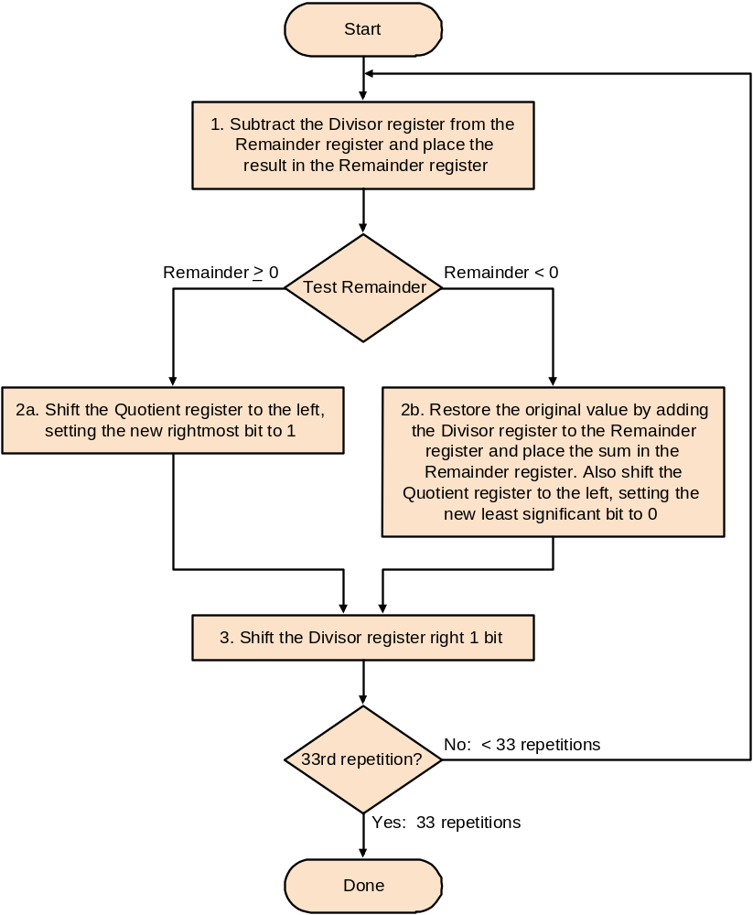
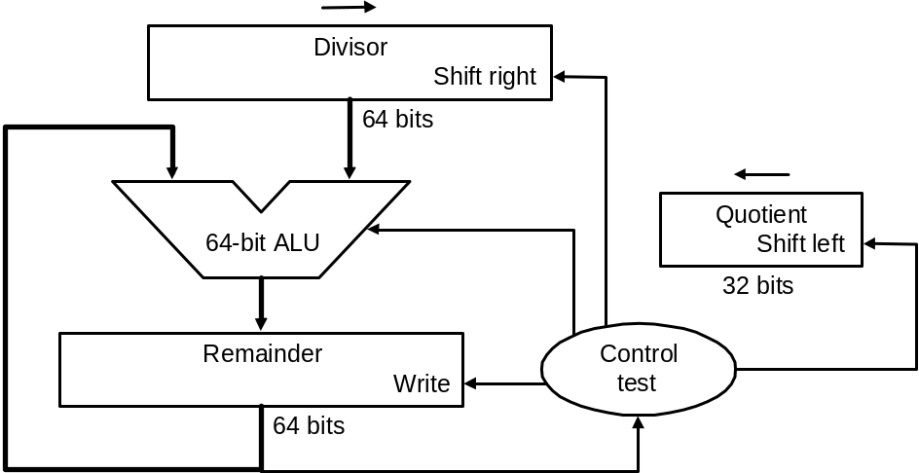
Division – 1st (simple) Version
Initialize:
Divisor reg with Divisor in left (high) 32 bits
and zeros in low 32 bits
Remainder reg with dividend right justified
padded with 0’s on left,.
Quotient reg with all zeros

Slide 18
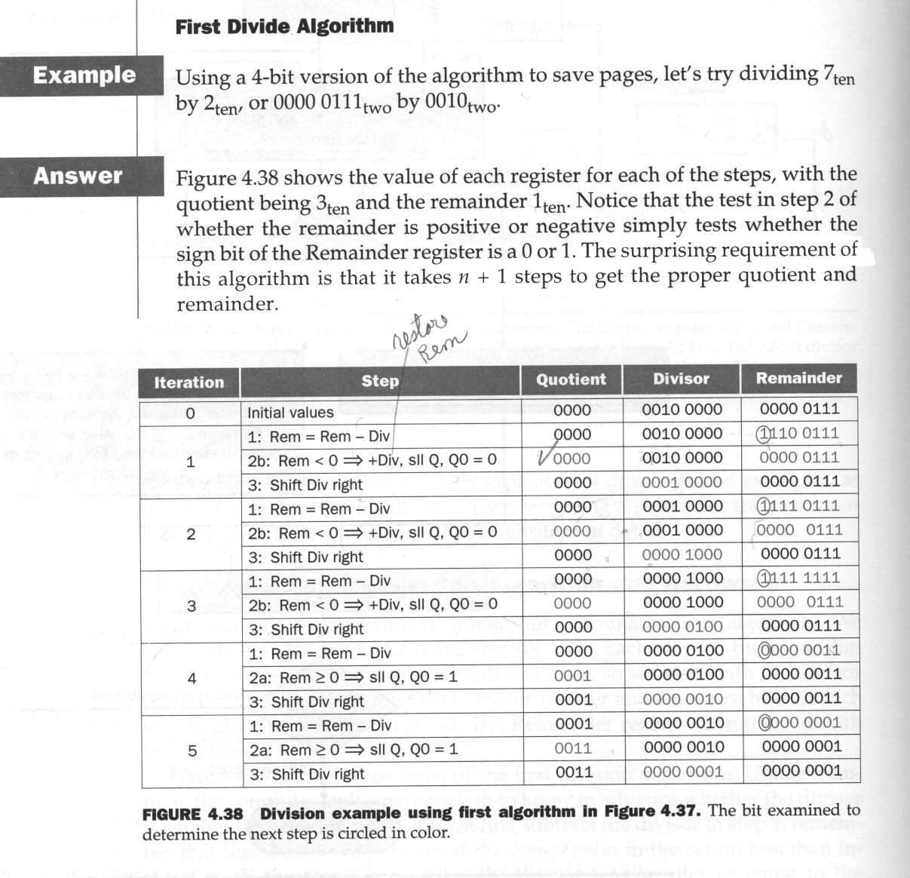
Division – 1st Version – Example

Slide 19
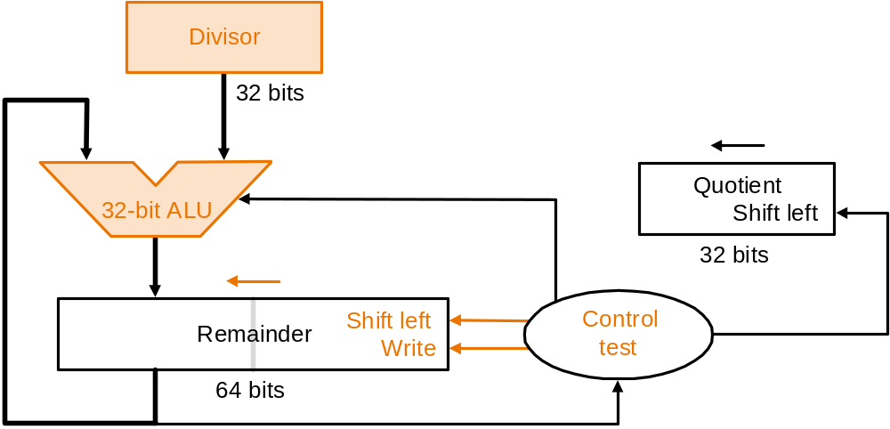
Second (intermediate ) Division Version
Divisor register is now stationary and ½ the size (32 bits)
Shift the Remainder/Dividend register left, instead of the divisor right
Shift before subtract instead of subtracting first.
Initialize:
Remainder reg with dividend left padded with 0’s right justified to bit 0.
– ALU uses only left side of reg. Entire Reg shifted after being written.
See example.

Slide 20
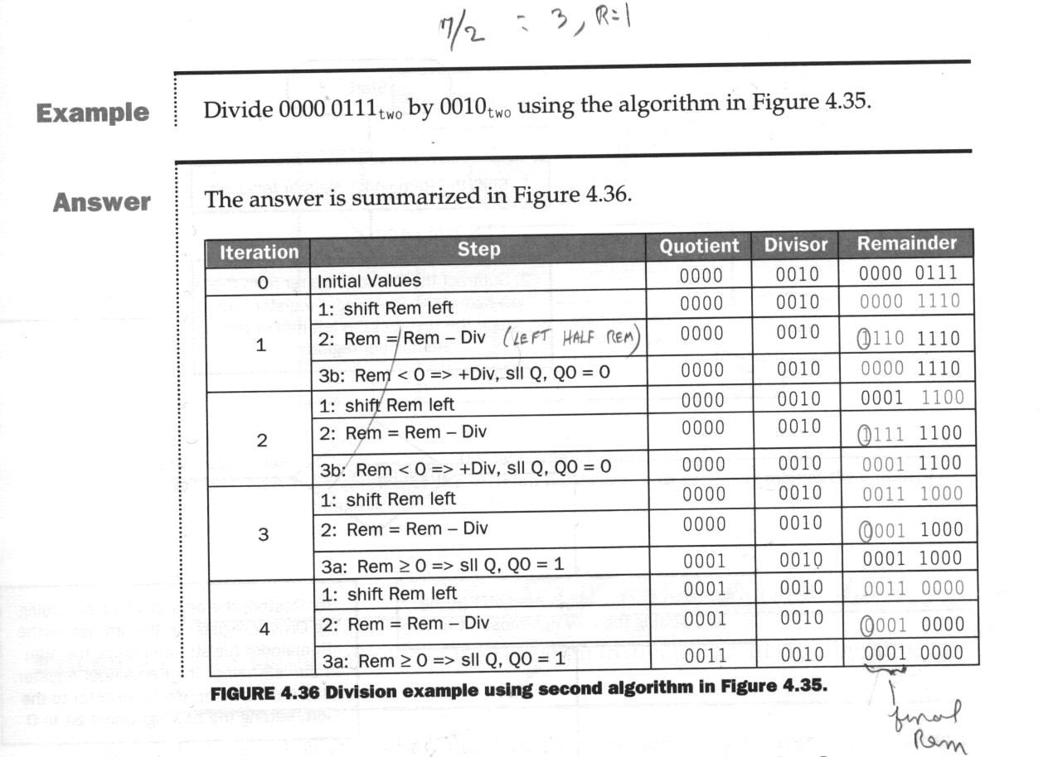
Second Division Version Example
Based on
Figure 4.39

Slide 21
Third (Final ) Division Version
Quotient reg is also eliminated because remainder reg is not fully utilized at low end, thus the quotient can be “grown” there.
Quotient and remainder now shifted
Because the quotient and remainder now shifted simultaneously, the shift before subtract scheme of the previous version will not work and we end up with an extra shift of the remainder.
  Thus the remainder (left half of remainder register) is given a 1 bit correction right shift at the end.
See next slide

Slide 22
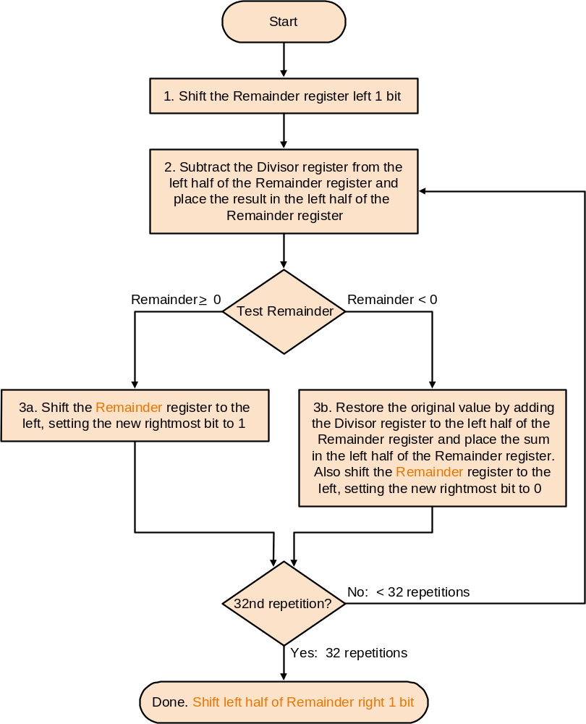
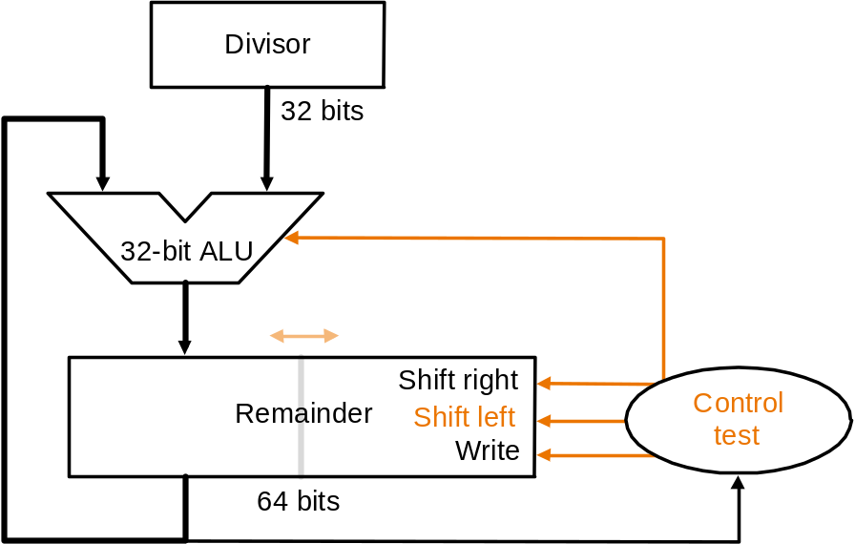
Third (Final ) Division Version (cont)
Initialize as in 2nd version:
Remainder reg with dividend left padded with 0’s right justified to bit 0.
– ALU uses only left side of reg. Entire Reg shifted after being written.
See example

Slide 23
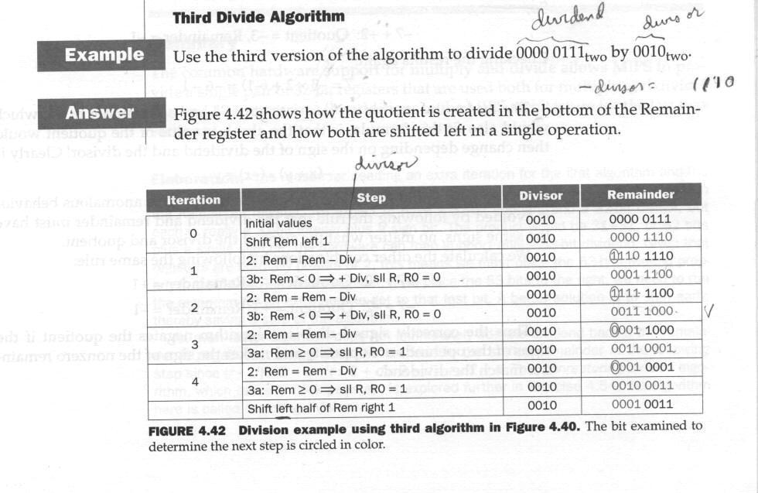
Third (Final ) Division Version Example

Slide 24
Signed Division
Quotient is negative if dividend and divisor have opposite signs – keep track of signs.
Remainder must have same sign as dividend no matter what the signs of divisor and quotient are.
  This is to guarantee that the basic division equation is satisfied:
  Remainder = (Dividend – Quotient x Divisor)

Slide 25
Hardware/Software Interface for Divide
(see p. 272)
New instructions (all type R):
  div $2, $3 # lo = $2/$3, hi = $2 mod $3 ... Signed division
  # lo = quotient, hi = remainder
  divu $2, $3 # lo = $2/$3, hi = $2 mod $3 ... Unsigned division
  # lo = quotient, hi = remainder
  mflo and mfhi are used as for multiplication
  Software must check for quotient overflow and divide by 0.

Slide 26
Floating Point Concept
Floating point is a standard way for representing “real” numbers ... From the analog world
  Real numbers have an integer and fractional part
Floating point representation is a standard (canonical) form of “scientific notation”
  N x 10E ... N is a decimal fraction = “mantissa”
        E is the exponent
        10 is the base
  We take advantage of the fact that the position of the decimal point in N can be shifted (“floated”) if we make corresponding adjustments to the exponent, E, in scientific notation.
Standard floating point representation in a computer is of the following form:
1.zzzzz... x 2^{yyyy} . This is a binary fraction - the base is 2 not 10
The exponent yyyy is in binary, but in documentation is represented as decimal for clarity.
yyyy is adjusted to a value which will result in a one digit integral part of the mantissa. The fractional part of the mantissa, zzzzz…, is called the “significand” in the text. … how would the number 0 be represented in floating point? See later.

Slide 27
Floating Point Concept Example
The floating point number is now given as:
(-1)^{S} x (1+significand) x 2E
Where the bits of the significand represent a fraction between 0 and 1,
and E specifies the value in the exponent field.
If we number the bits of the significand from left to right as: s1, s2, s3, …
Then the floating point “value” is:
(-1)^{S} x [1+ (s1 x 2⁻¹) + (s2 x 2⁻²) + (s3 x 2⁻³)+(s4 x 2⁻⁴)+ … ] x 2E
Example:
Let S=0, E=3, significand = 01000101
Fractional part = 0x2⁻¹ + 1x2⁻² + 0x2⁻³ + 0x2⁻⁴ + 0x2⁻⁵ + 1x2⁻⁶ + 0x2⁻⁷+1x2⁻⁸
= 1/4 + 1/64 + 1/256+ … = 0.26953125… ==> 0.27
Value in decimal is (-1)⁰ x 1. 26953125… x 2³ = 8x1.27 = 10.16
NOTE: This does not take the “bias” additive constant for exponent into account - see later for this “feature”

Slide 28
Floating Point Representation
(-1)^{S} x 1.Z x 2E (omitting exponent bias – see later)
  S is the sign of the entire number
  ... Sign magnitude representation used
  E is the exponent, 8 bits - signed 2's complement
  Z is the significand , 23 bits
  Only the fractional part of the mantissa is represented
  because the integer part in binary is always 1
  Exponent can range from -126 → -1, and 0 → 127
  Giving an overall range of about 2.0 x 10⁻³⁸ thru 2.0 x 10³
  Note that some bit combinations of the exponent are not allowed, namely those for –127 = 10000001, and –128 = 10000000
  this would allow the “biased” exponent to have the positive range: 1 though 254 as desired (see later)
  This representation is used for the float type in C language

Slide 29
Double Precision Floating Point
Two words for the representation
1st word is similar to regular floating point, but:
  11 bits given for exponent
  20 bits given for part or the significand
A second 32 bit word allowed for the remainder of the significand.
Exponent can range from -1022 → -1, and 0 → 1023
Giving an overall range of about
2.0 x 10⁻³⁰⁸ thru 2.0 x 10³⁰⁸
This is the double data type in C

Slide 30
Bias Adjustment For Exponent
We now finally define what is meant by bias for the exponent.
Sorting floating point numbers is a problem because the leading 1 in a negative exponent would be interpreted as a large positive number .... Thus:
A bias of 127 is added onto the exponent of a normal float and a bias if 1023 is added onto a double float
General formula for evaluation is now:
value = (-1)^{S} x (1 + significand) 2^{(exponent - bias)}
With the allowed exponent range of
-126 through 127 for single precision
-1022 through 1023 for double precision
The respective corresponding biased exponents are strictly positive as desired:
1 though 254 = 11111110)_{two} for single precision
1 though 2046 = 11111111110)_{two} for double precision

Slide 31
IEEE 754 Standard for Floating Point
Single precision format
Double precision format
S sign | E: Biased Exponent 8 bits | Z Significand 23 bits
Bit index 31 30 23 22 0
S sign | E: Biased Exponent 11 bits | Z Significand 20 bits
Bit index 31 30 20 19 0
Significand continued 32 bits

Slide 32
Special Representations (incl. Zero) in the IEEE 754 Standard Floating Point
“Ordinary” numbers will have exponents between E_{min} and E_{max} inclusively, where
  E_{min} = -126 for single precision and –1022 for double precision
  E_{max} = 127 for single precision and 1023 for double precision
Some exponents outside of this range may get special interpretation:
  If exponent is E_{min} – 1 and the fractional part is all zeros, then this represents the number zero in floating point.
  If exponent is E_{min} – 1 and the fractional part is not all zeros, then value is less than 1.0x2^{Emin} cannot have the implied “1” integral part. In this case the representation is 0.f x 2^{Emin}, where f is the fractional part.
  If exponent is E_{min} + 1 and the fractional part is all zeros, then this represents ±∞. If the fractional part is not zero, then this is a “NaN” (“Not a Number”)
See the posted Goldberg’s article page H-16 for further detail.

Slide 33
Converting Between a Decimal Number and Binary Floating Point An Example
Use the previous example: 10.16)_{ten}.
Convert to a single precision binary Floating point number with bias.
Integral part: 10)_{ten} = 1010)_{two}
Fractional part: 0.16)ten = 0.0010100011110… use the “doubling” algorithm: double the
fraction and retain the integral part:
0.16x2=0.32, 0.32x2 = 0.64, 0.64x2 = 1.28, 0.28x2=0.56, 0.56x2=1.12, 0.12x2=0.24, etc.
10.16)_{ten} = 1010.0010100011110… x2⁰ = 1.0100010100011110… x 2³
Adding bias: we have: 1.0100010100011110… x 2⁽³⁺¹²⁷⁾ = 1.0100010100011110… x 2¹³⁰
sign(1) exponent(8) significand (23)
Reversing the process:
Removing the bias: 1.0100010100011110… x 2⁽¹³⁰⁻¹²⁷⁾ = (1+1/4 + 1/64 + 1/256 + …) x 2³ =
1.269… x 8 = 10.156… ≈ 10.16)_{ten}
0 | 10000010 | 0100010100011110…

Slide 34
Floating Point Addition
(See Figs 4.44, 4.45 - pp. 284, 285 )
Pseudo Code:
Compare the exponents of the two numbers and align:
  Shift the smaller number (mantissa) to the right (holding binary point fixed) until its exponent matches the larger exponent – actually we are effectively shifting the binary point left.
  Note: the integral part participates in the shift - the hardware must supply or account for the binary integral part of ‘1’.
  Over/under flow cannot occur on this initial re-alignment of the binary point because the smaller exponent will adjust until it matches the larger exponent which is assumed ok.
Add the significands - really the aligned mantissas since the integral parts participate . - see not below.
Loop:
  Normalize the sum by shifting right or left and inc/dec the exponent – may end up being
  un-normalized if addition or rounding (below) caused a integral part of > 1 bit.
  Overflow or underflow in exponent?
  If yes exception raised
  If no, then round significand to proper number of bits
Repeat normalization (goto loop) if no longer normalized

Slide 35
Floating Point Addition (cont)
Note on the “addition” step:
  The addition of the mantissas is a “signed magnitude” operation, we must do an unsigned addition/subtraction of the numbers:
  The mantissa/significand does not have a sign bit as in 2 complement form.
  Between the overall sign of the numbers, and the overall (net) operation (add or subtract) we do unsigned addition if there is no “net” subtract, or an unsigned 2’s complement subtraction if there is a “net” subtract. For a net subtract, we determine the sign of the answer by observing the carryout:
  For subtraction, conceptually:
  Hardware checks carry out in the 2’s complement sum
  If there is a carry out, answer is positive
  If no carry out, answer is negative and in 2's comp form
  Example:
  5 + (-7) = 5 - (+7) = 5 - (2's comp of 7) ... no c.o. => answer neg
  7 + (-5) = 7 - (+5) = 7 - (2's comp of 5) ... is c.o. => answer pos

Slide 36
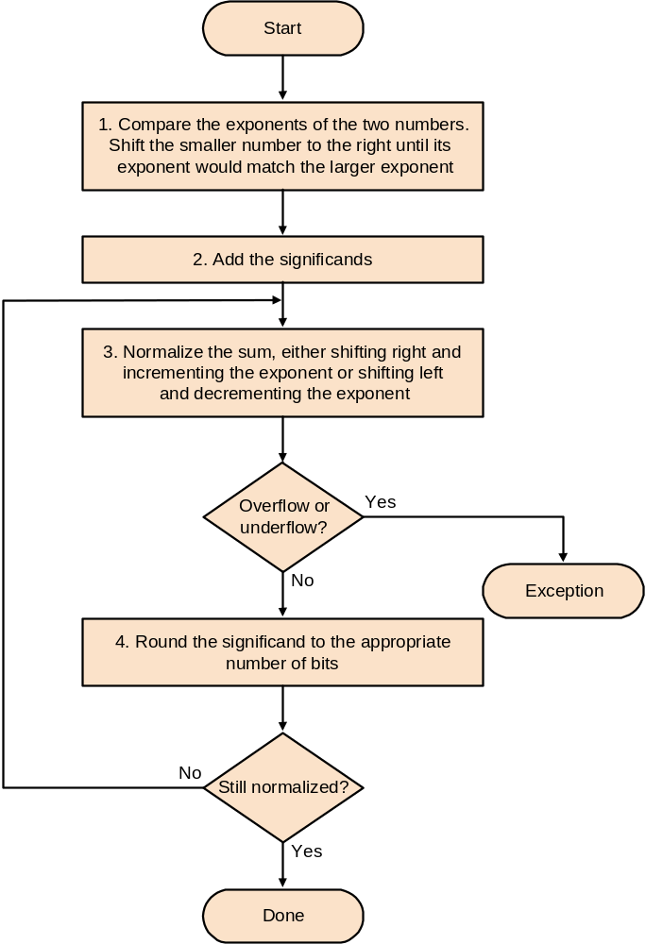
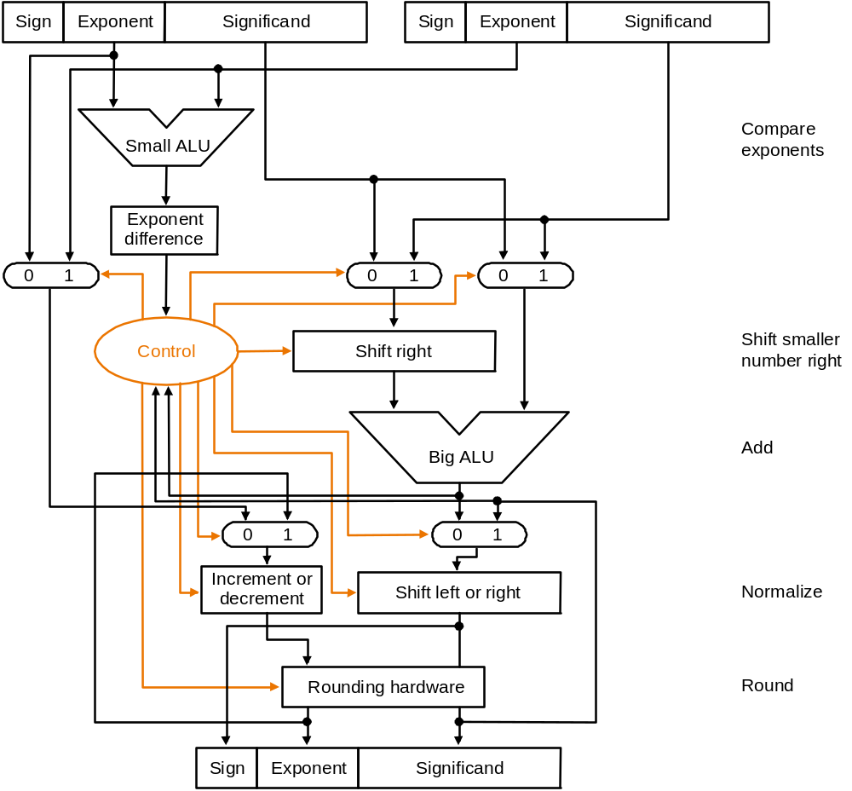
Floating Point Addition –Data Flow
←for re-normalization
Rounding up (add 1)
Could cause > 1 bit to left of
Significand.
Note: over flow is when a positive exponent is too large for exponent field
Underflow is when negative exponent is too large for exponent field.

Slide 37
Example of Floating Point Addition
Add 0.5 and –0.4375 (both base 10) to give 0.0625
Floating point representations, assuming 4 bits of precision:
0.5)_{ten} = 0.1)_{two} x 2⁰ = 1.000)_{two} x 2⁻¹ adding bias gives: 1.000 x 2¹²⁶
–0.4375 )_{ten} = -0.0111 )_{two} x2⁰ = -1.110 )_{two} x 2⁻² adding bias gives: -1.110 x 2¹²⁵
Shift the smaller number to get the same exponent as the larger to make exponents
match: -1.110 x 2¹²⁵ = -0.111x2¹²⁶
Adding significands: 1.0 x2¹²⁶ + (-0.111x2¹²⁶ ) = 1.0 x2¹²⁶ + (-0.111x2¹²⁶ )
= 1.0 x2¹²⁶ + 1.001x2¹²⁶ ) , used 2’s complement of 2nd number
= 0.001 x 2¹²⁶ … since there was a net carryout, the sum is positive.
Normalize: = 1.000 x 2¹²³ … no overflow since biased exponent is between 0
and 255.
Round the sum: no need to, it fits in 4 bits.
Final answer with bias removed is: 1.000 x 2⁽¹²³⁻¹²⁷⁾ = 1.000 x 2⁻⁴ = 0.0625)_{ten}

Slide 38
Floating Point Multiplication see fig 4.46, p. 289
As with addition, the process of multiplication and the process of rounding can produce a non-normalized number ... Which in turn can result in over/under flow on re-normalization.

Slide 39
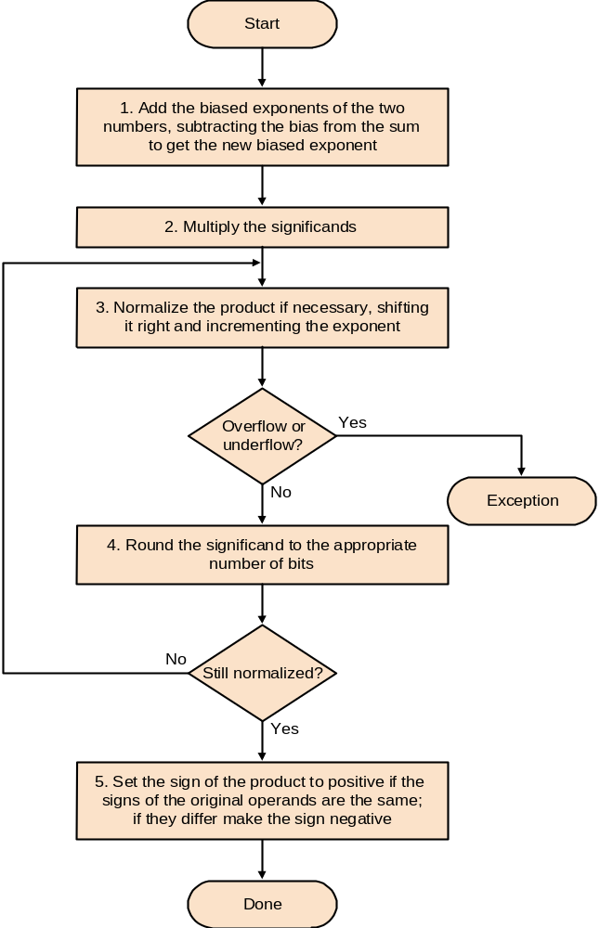
Floating Point Multiplication (cont)

Slide 40
Example of Floating Point Multiplication
Multiply 0.5 and –0.4375 (both base 10) to give -0.21875 = 0.00111)_{two}
From before: (1.000 x 2⁽⁻¹⁺¹²⁷⁾) x (-1.110 x 2⁽⁻²⁺¹²⁷⁾) using biased exponent.
Adding exponents (and dropping the extra bias): 126+125-127 = 124
Multiply mantissas using a previously described multiply algorithm:
1.110 x 1.000 = 1.110000
Yielding: 1.110000 x 2¹²⁴ = 1.110 x 2¹²⁴ keeping to 4 bits
Product is already normalized and no overflow since 1 ≤ 124 ≤ 254
Rounding makes no change
Signs of operands differ, hence answer is negative: -1.110 x 2⁻³
Converting to decimal: -1.110 x 2⁻³ = -0.001110 = -0.21875)_{ten}

Slide 41
Floating point instructions
Floating point registers
See p. 290-291
Floating point instructions
See p. 288 and 291 (fig 4.47)

